Slide 1
IN723 BGP Lesson 5
iBGP vs eBGP
Route reflector
Confederation
Peer group
Neighbor shutdown
Authentication
Configuration updates
Peer reset
ORF
Dampening

Slide 2
Resources
Case Studies
http://www.cisco.com/c/en/us/support/docs/ip/border-gateway-protocol-bgp/26634-bgp-toc.html
Configuration Guide
http://www.cisco.com/c/en/us/td/docs/ios-xml/ios/iproute_bgp/configuration/15-mt/irg-15-mt-book.html
Command Reference
http://www.cisco.com/c/en/us/td/docs/ios-xml/ios/iproute_bgp/command/irg-cr-book.html
Notes:
Microsegmentation = split a larger collision domain into smaller ones in order to reduce collision probability

Slide 3
iBGP full mesh & route reflectors
iBGP assumes a full mesh between all iBGP peers within an AS
Therefore a router will not advertise an iBGP learned route to any other iBGP peer
Requires full mesh = scale & administration overhead issues
Can be solved using route reflectors or confederations
Route reflector is the recommended way
Being a route reflector allows a router to advertise (reflect) iBGP-learned routes to other iBGP speakers
Notes:
Because redistributing BGP into IGP is dangerous (too many routes can overload)

Slide 4
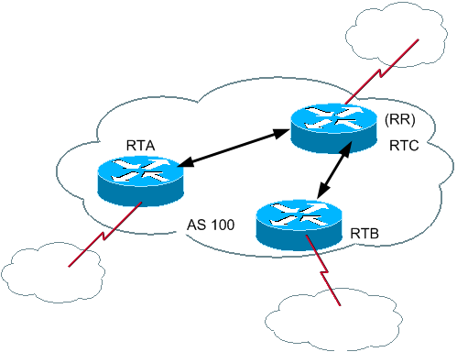
Route Reflector
RTA & RTB are route reflector clients of RTC

Slide 5
Route Reflectors cont …
Config applied to route reflector only, on a peer by peer basis.
router bgp 100
neighbor 192.168.1.2 route-reflector-client
When a RR receives updates:
Update from a nonclient iBGP peer—Send the update to all clients in the cluster & eBGP peers.
Update from a client iBGP peer—Send the update to all nonclient peers, all client peers and all eBGP peers.
Update from eBGP peer—Send the update to all nonclient peers, all client peers and eBGP peers.
Notes:
TNZ Core – CLNE are RR clients of PE, PE are RR clients of core RRs.
Cluster = RR & its clients

Slide 6
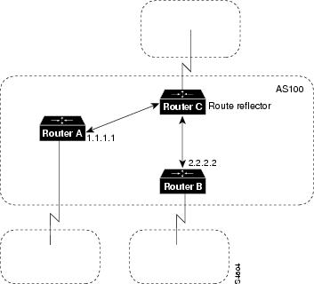
Route Reflectors cont …
Route reflectors do not change the next hop (avoid being transit)
Setting next-hop-self on RR only changes next-hop of eBGP learned routes to RR clients
32-bit Originator-id set by Route-Reflector = Router id of route originator. Used for loop prevention
Notes:
Can use an inbound route-map on RR client(set ip next-hop peer-address) to modify next-hop for RR-client learned routes advertised by a RR.
RR will reflect routes back to originator = if originator-id matches local then prefix dropped.

Slide 7
Route Reflectors cont…
Multiple route reflectors can be configured for redundancy.
When a cluster has more than one route reflector - all route reflectors in the cluster need to be configured with a 4-byte cluster ID
The cluster ID allows route reflectors to recognize updates from other route reflectors in the same cluster
A cluster list is a sequence of cluster IDs that an update has traversed. When a route reflector sends a route from a client to non-client, it appends the local cluster ID to the cluster list
If the route reflector receives an update whose cluster list contains the local cluster ID, the update is ignored
Notes:
Default cluster ID = router id. Change with ‘bgp cluster-id’ command.

Slide 8
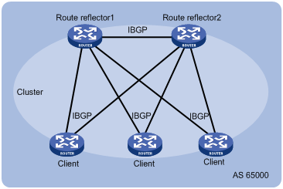
Route Reflector Cluster

Slide 9
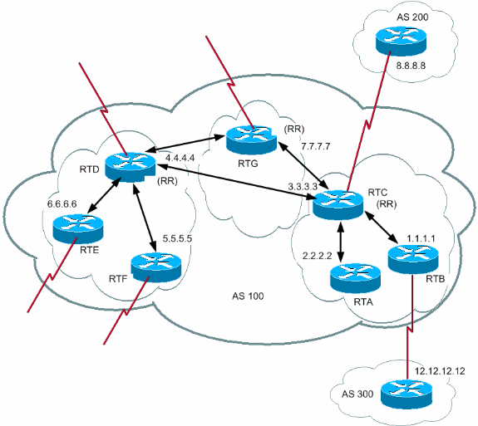
Route Reflector Hierachy
Notes:
Hierarchical
Route reflectors are clients of other route reflectors

Slide 10
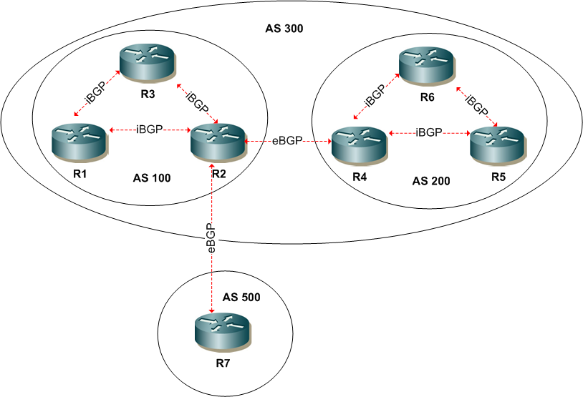
Confederations
Technique for reducing iBGP mesh
Break AS up into smaller sub ASes
Notes:
eBGP between confederation sub AS’s does not change next hop, local-pref or MED
Confederations can be combined with route-reflectors

Slide 11
Confederations cont …
eBGP between confederation sub AS’s does not change next hop, local-pref or MED
Confederations can be combined with route-reflectors

Slide 12
Problem - Route is not being advertised to peer
Usually as a result of the route being learned via an iBGP session and therefore will not be advertised to another iBGP peer (iBGP assumes full mesh)
show ip bgp 192.168.10.0
BGP routing table entry for 192.168.10.0/24, version 11
Paths: (1 available, best #1, table Default-IP-Routing-Table)
Not advertised to any peer
4771
172.18.43.111 from 172.18.43.111 (172.18.23.229)
Origin IGP, metric 100, localpref 100, valid, external, best

Slide 13
Peer Groups
Peer groups reduce system resources required for update generation
The route table is checked once and updates are replicated to all peer group members rather than individually
Simplify configuration
All peer group members must share identical outbound policies (except for default-originate)

Slide 14
Peer Groups cont …
Example config
router bgp 100
neighbor internal peer-group
neighbor internal remote-as 100
neighbor internal update-source loopback 0
neighbor internal route-map set-med out
neighbor internal filter-list 1 out
neighbor internal filter-list 2 in
neighbor 171.69.232.54 peer-group internal
neighbor 171.69.232.55 peer-group internal
neighbor 171.69.232.55 filter-list 3 in
neighbor external-peers peer-group
neighbor external-peers route-map set-metric out
neighbor external-peers filter-list 99 out
neighbor external-peers filter-list 101 in
neighbor 171.69.232.100 remote-as 300
neighbor 171.69.232.100 peer-group external-peers
neighbor 171.69.232.110 remote-as 400
neighbor 171.69.232.110 peer-group external-peers
neighbor 171.69.232.110 filter-list 400 in

Slide 15
Peer Groups cont …
Common ISP groupings:
Normal iBGP peer group for normal iBGP peers
iBGP client peer group for reflection peers on a route reflector
eBGP full-routes for peers to receive full Internet routes
eBGP customer-routes for peers to receive only routes from direct customers of the ISP
eBGP default-routes for peers to receive the default route, and possibly a few other routes

Slide 16
neighbor shutdown
neighbor <ip address> shutdown
Configuration command that terminates session for specified neighbor and removes all associated routing information
neighbor <peer-group name> shutdown
Can also be applied to peer groups
Notes:
Advantage = Peer set down, but related configuration commands remain and can be reactivated

Slide 17
BGP Authentication
BGP supports message digest 5 (MD5) neighbor authentication.
MD5 sends a “message digest” (also called a “hash”), which is created using the key and a message.
The message digest is then sent instead of the key.
The key itself is not sent, preventing it from being read by someone eavesdropping on the line while it is being transmitted.
To enable MD5 authentication on a TCP connection between two BGP peers, use the router configuration command:
neighbor {ip-address | peer-group-name} password string
Notes:
Each segment sent on TCP connection is verified

Slide 18
Configuring MD5 Authentication
AS 65000
AS 65500
.1
10.64.0.0 /24
.2
R1
R2
R1(config)# router bgp 65000
R1(config-router)# neighbor 10.64.0.2 remote-as 65500
R1(config-router)# neighbor 10.64.0.2 password BGP-Pa55w0rd
R1(config-router)#
R2(config)# router bgp 65500
R2(config-router)# neighbor 10.64.0.1 remote-as 65000
R2(config-router)# neighbor 10.64.0.1 password BGP-Pa55w0rd
R2(config-router)#

Slide 19
Config Changes
Changes in the BGP routing policy require the peer connections to be reset
To hard reset all BGP sessions (will take them down then re-establish)
clear ip bgp *
To hard reset a specific neighbor
clear ip bgp <neighbour IP address>
Notes:
Policy changes need to be rerun against received / inbound routing information (prefixes) or sent / outbound routing information (prefixes)

Slide 20
Config Changes cont …
Rather than a full reset you can issue a soft reconfiguration
Reconfigures & activates policies without clearing the session
Can be applied inbound, outbound or both
2 Ways to do a soft reset inbound:
Dynamic / Route Refresh
Stored routing update information

Slide 21
Dynamic / Route Refresh
Does not require pre configuration or additional memory
Requires both routers to support route refresh capability (IOS 12.1)
Confirm with show ip bgp neighbors
#show ip bgp neighbors
BGP neighbor is 172.18.43.111, remote AS 4771, external link
BGP version 4, remote router ID 172.18.23.229
BGP state = Established, up for 1w2d
Last read 00:00:07, hold time is 24, keepalive interval is 8 seconds
Neighbor capabilities:
Route refresh: advertised and received(old & new)
Address family IPv4 Unicast: advertised and received
Can then use
clear ip bgp soft in
Notes:
tells our peer to send us a BGP UPDATE message with all the NLRI so that we can re-run everything through our new inbound policy

Slide 22
Stored Routing Update Information
If route refresh is not supported
Can configure BGP router to separately store inbound updates (unmodified by local inbound policies)
router bgp 100
neighbor 192.168.1.1 soft-reconfiguration inbound
Then can issue
clear ip bgp soft in
Will reapply inbound policies to the stored updates from that neighbour
Requires additional memory to store the updates
Notes:
Route refresh requires significantly less memory

Slide 23
Soft Reset Outbound
Does not require any configuration
clear ip bgp soft out

Slide 24
What prefixes are being advertised to a specific peer ?
show ip bgp neighbors <ip> advertised-routes
IP3AK1-B21#show ip bgp neighbors 172.18.43.111 advertised-routes
BGP table version is 27, local router ID is 172.28.154.126
Status codes: s suppressed, d damped, h history, * valid, > best, i - internal,
r RIB-failure, S Stale
Origin codes: i - IGP, e - EGP, ? - incomplete
Network Next Hop Metric LocPrf Weight Path
*> 10.232.50.0/24 0.0.0.0 0 32768 i
*> 172.18.43.110/31 0.0.0.0 0 32768 i
*> 172.20.232.0/24 0.0.0.0 0 32768 i
*> 172.28.154.126/32
0.0.0.0 0 32768 i
*> 200.1.1.0 0.0.0.0 0 32768 i
Notes:
To see advertised routes after any local outbound policy (filtering) has been applied.
Use show ip bgp to see routes before local policy applied

Slide 25
What prefixes are being received from a specific peer ?
show ip bgp neighbors <ip> received-routes
Requires soft-configuration inbound to be configured
show ip bgp neighbors 172.18.43.111 received-routes
% Inbound soft reconfiguration not enabled on 172.18.43.111
(config-router)#router bgp 64512
(config-router)#neighbor 172.18.43.111 soft-reconfiguration inbound
IP3AK1-B21#show ip bgp neighbors 172.18.43.111 received-routes
BGP table version is 27, local router ID is 172.28.154.126
Status codes: s suppressed, d damped, h history, * valid, > best, i - internal,
r RIB-failure, S Stale
Origin codes: i - IGP, e - EGP, ? - incomplete
Network Next Hop Metric LocPrf Weight Path
*> 0.0.0.0 172.18.43.111 64000 0 4771 i
Notes:
Shows received routes before any local policy applied

Slide 26
ORF
Outbound route filtering allows a BGP speaker to tell a peer what its inbound policy is
This allows the remote speaker to filter the routes before they are advertised
This prevents the advertising of unwanted routes
router bgp 100
neighbor <ip> capability orf prefix-filter [receive | send | both]
send = advertise local inbound filter to neighbor so it can apply it to outbound policy
receive = accept peers inbound filter and apply outbound
Notes:
Must be supported by both ends

Slide 27
Dampening
Used to minimise instability caused by route flapping
A route that is flapping receives a penalty of 1000 (default) for each flap
When the accumulated penalty reaches a configurable limit (2000), BGP suppresses advertisement of the route even if the route is up
The accumulated penalty is decremented at rate = 1/2 per half-life time (15 mins). When the accumulated penalty is less than the reuse limit (750), the route is advertised again (if it is still up)
Dampening not applied to iBGP learned routes
router bgp 100
bgp dampening

Slide 28
Dampening cont …
RouterA# show ip bgp
table version is 32, local router ID is 203.250.15.2
Status codes: s suppressed, d damped, h history, * valid, > best, i - internal
Origin codes: i - IGP, e - EGP, ? - incomplete
Network Next Hop Metric LocPrf Weight Path
*d 192.208.10.0 192.208.10.5 0 0 300 i
*> 203.250.15.0 0.0.0.0 0 32768 i
RouterA# show ip bgp 192.208.10.0
BGP routing table entry for 192.208.10.5 255.255.255.0, version 32
Paths: (1 available, no best path)
300, (suppressed due to dampening)
192.208.10.5 from 192.208.10.5 (192.208.10.174)
Origin IGP, metric 0, external
Dampinfo: penalty 2615, flapped 3 times in 0:05:18, reuse in 0:27:00

